Slide 1
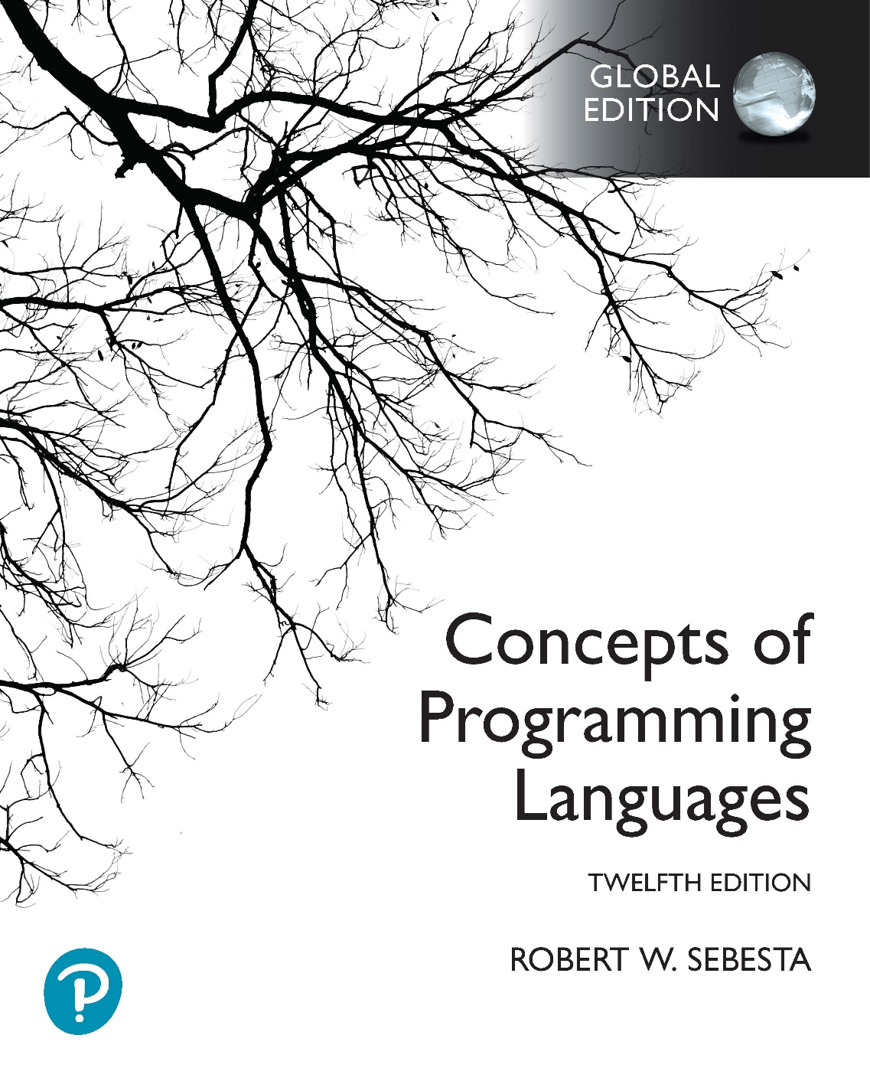
Chapter 15 Part 2
Functional Programming Languages

Slide 2
Chapter 15 Topics
Introduction to Scheme
Numeric Predicate Functions
Control Flow
List Functions
Predicate Functions for Lists
Predicate Functions for Equivalence
The let Function
Example Scheme Functions

Slide 3
Numeric Predicate Functions
Predicate function
A function that defines a Boolean value
The value #t is true, the value #f is false
Sometimes () is used for #f
Any non-null list is interpreted as #t
Predefined predicate functions for numbers
For multiple parameters
‎=, <>, >, <, >=, and <=
Single value tests
‎even?, odd?, zero?, negative?, positive?
The not function is applied to a Boolean parameter
Inverts the logic of a Boolean expression
Notes:
In Scheme, <> refers to the “not equals” comparison.
Again, note that =, <>, >, <, >=, and <= are actually the names of functions.
Finally, these numeric predicate functions only work for numeric atoms, not symbolic atoms.

Slide 4
Control Flow: if function
Two-way selector, with the following general form
(if predicate then_exp else_exp)
For example
(define (divide numer denom)
(if (<> denom 0)
(/ numer denom)
0
)
)
Notes:
In this example, define produces a function named “divide”, which takes two parameters, “numer” and “denom”.
The function tests to see if denom is 0. If it is, the result of the entire divide function is 0.
If denom is not 0, numer is divided by denom, and the result of this division becomes the result of the divide function.
Again, note that if is a function. Its parameters are two expressions. Each expression can either be a simple value, like 0, or a function application, like (/ numer denom).

Slide 5
Control Flow: cond function
Multiple selector, with the following general form
(cond
(predicate_1 expression)
(predicate_2 expression)
...
(predicate_n expression)
(else expression)
)
Evaluates to the value of the expression for the first predicate that evaluates to true
If no predicate is true
Evaluates to the optional else expression
Evaluation is unspecified if no else is provided
Notes:
The cond function is discussed in Section 8.2.2.4 of the textbook.
Often you’ll see cond used where an if would also work (i.e. when there are only two predicate-expression pairs in the cond). Either is correct in a test/exam situation.

Slide 6
Control Flow: Repetition
How do we handle repetition in Scheme?
Scheme is a pure functional programming language
There are no variables
Therefore no loop control variables or loops
All repetition is handled through recursion

Slide 7
List Functions: quote
The Scheme interpreter (named eval)
Always evaluates parameters of function applications
Lists have the same form as functions
(A B C) versus (member A list)
Lists should not be evaluated when they are parameters
The quote primitive function
Used to avoid parameter evaluation when not appropriate
Takes one parameter, returns parameter without evaluation
For example
(foo (quote (A B C))) rather than (foo (A B C))
Can be abbreviated with the apostrophe prefix operator
'(A B) is equivalent to (quote (A B))
Copyright © 2023 Addison-Wesley. All rights reserved.
1-7
Notes:
List functions are discussed in Section 6.9 of the textbook.
It’s interesting to note that eval (and therefore the Scheme interpreter itself) is also a function.
In the example, (foo (quote (A B C))), the function named foo is applied to one parameter (a list containing the atoms A, B, and C). We prefer using (foo ‘(A B C)) instead, because it is easier to read and less typing.
In the example, (foo (A B C)), we are first applying the function named A to the parameters B and C, getting the result, and then applying the function named foo to the result. If there is no function named A, the interpreter will give you an error.
What this implies is that a quote must be included whenever a list is used as a parameter.

Slide 8
List Functions: list function
The list function
Takes any number of parameters
Yields a list with the parameters as elements
(list 'A 'B 'C) yields (A B C)
(list 'A 'B '(C D)) yields (A B (C D))
Notes:
Note how single symbolic atoms must also be quoted when they’re used as parameters. Without the quote, Scheme will interpret them as names. Therefore, A is interpreted as the name A, while ‘A is interpreted as a symbolic atom A. The atoms in the lists aren’t quoted, because the lists aren’t being interpreted as functions.
The parameters of list are inserted without modification into the returned list. Therefore:
(list ‘(A) ‘(B) ‘(C)) yields ((A) (B) (C))
(list ‘(A) ‘B ‘C) yields ((A) B C)
(list ‘(A)) yields ((A))

Slide 9
List Functions: car and cdr
List functions in Scheme
The car function yields first element of its list parameter
(car '(A B C)) yields A
(car '((A B) C D)) yields (A B)
(car 'A) produces an error
(car '()) produces an error
The cdr function yields remainder of its list parameter after first element has been removed
(cdr '(A B C)) yields (B C)
(cdr '((A B) C D)) yields (C D)
(cdr '(A)) yields ()
(cdr 'A) produces an error
(cdr '()) produces an error
Notes:
Lists in Scheme are immutable. This means that functions producing lists as a result generate a new list (in other words, a cdr produces a new list, not a pointer or reference into the parameter list).
Note, in particular, that the result of a cdr on a list containing a single element is an empty list. It helps if you think about lists as containers for elements, where the last element is implicitly an empty list. This idea is often used as a base case in a recursive function, to determine when the end of the list has been reached.

Slide 10
List Functions: cons function
List functions in Scheme
The cons function puts its first parameter into its second parameter, a list, to make a new list
(cons 'A '(B C)) yields (A B C)
(cons '(A B) '(C D)) yields ((A B) C D)
(cons '() '(A B)) yields (() A B)
(cons 'A 'B) yields the dotted pair (A . B)
(cons '(A B) 'C) yields the dotted pair ((A B) . C)
Notes:
Remember that lists in Scheme are immutable. This means that CONS does not modify any parameters, but produces a new list.
If the second parameter of a cons is an empty list, the result is simply the first parameter placed inside a list. So the result of (cons ‘A ‘()) is (A), while the result of (cons ‘(A B) ‘()) is ((A B)).
If the last parameter of cons is a single element, you get what is called a dotted pair, which does not work like a list. Generating a dotted pair is usually not what you want when working with lists. If you get output with dots in when you expect a list, you are probably trying to apply cons with a second parameter that is an atom. Try using list instead of cons if this happens.

Slide 11
List Predicates: list? & null?
The list? predicate function
Takes one parameter
Yields #t if parameter is a list, #f otherwise
The null? predicate function
Takes one parameter
Yields #t if parameter is empty list, otherwise yields #f
Note that the parameter must be completely empty
null? will yield #t if the parameter is ()
null? will yield #f if the parameter is (())

Slide 12
Equivalence Predicates: eqv?
The eqv? predicate function
Yields #t if two values are the same
Works for both symbolic and numeric atoms
For example
(eqv? 3 3) yields #t
(eqv? 'A 'A) yields #t
(eqv? 'A 'B) yields #f
(eqv? 3.4 (+ 3 0.4)) yields #t
Does not work for lists
(eqv? '(A B) '(A B)) yields #f
Floats and integers are different values
(eqv? 3.0 3) yields #f
(= 3.0 3) yields #t

Slide 13
Equivalence Predicates: eq?
The eq? predicate function
Yields #t if two parameters are the same object in memory (i.e. performs a pointer comparison)
Examples
(eq? 'A 'A) yields #t
(eq? 'A 'B) yields #f
(eq? 'A '(B C)) yields #f
Note: For two list parameters, the result is not reliable
(eq? '(A B) '(A B)) yields #t or #f
Note: eq? is not reliable for numeric atoms
(eq? 3.4 (+ 3 0.4))) yields #t or #f
In most cases eqv? is more appropriate than eq?
Notes:
In this case, “not reliable” means that the result is dependent on context in a program and the Scheme interpreter’s implementation. Depending on how lists and numeric atoms are created on a lower level, the results vary (sometimes they are the same object in memory, sometimes not).

Slide 14
The let Function
General form:
(let
(
(name_1 expression_1)
(name_2 expression_2)
...
(name_n expression_n)
)
body
)
Semantics
Bindings: Evaluate expressions, bind their values to names
Body: Evaluate using names in bindings
The let function yields the value of the body
Notes:
The let function is discussed in Chapter 5 of the textbook.

Slide 15
The let Function
(define (computation a b c d)
(let
(
(top (+ a b))
(bottom (- c d))
)
(/ top bottom)
)
)
(define (computation a b c d)
(let
(
(top (+ a b))
(bottom (- c d))
)
(display (/ top bottom))
(newline)
(* top bottom)
)
)
Multiple function applications allowed in body
Function applications are evaluated in sequence
The let construct yields the value of the last application

Slide 16
Example Scheme Function: member
The member function
Applied to an atom (atm) and a simple list (lis)
Yields #t if atom is in the list, #f otherwise
Strategy: Recursively compare atm to each list atom; Return #t if atm found, #f if all list atoms are exhausted
(define (member atm lis)
(cond
((null? lis) #f)
((eq? atm (car lis)) #t)
(else (member atm (cdr lis)))
)
)
Notes:
In the exam, I will ask you to write code. The programs will never be more complex that the ones in these slides. I very strongly recommend that you ensure that you can write the programs in the Scheme practical as well.
This example defines a function named member, which is applied to two parameters, atm (the atom being searched for) and lis (the list in which we’re searching for atm).
The function is recursive, because it uses the member function. It has two base cases, and one recursive case.
Our strategy is as follows: We check to see if the first item in the list is the atom we’re looking for. If it is, the result is true (we’ve found the item). If it isn’t, we ignore the first item in the list, and do a membership test on the remaining items. We keep doing this until either we’ve found the atom we’re looking for, or we run out of elements. If we run out of elements, we know the item isn’t in the list, and the result is false.
The first base case is if the list is empty (tested by null?). This happens if either an empty list is provided as input when the user calls member, or if we’ve run out of elements to check (i.e. the entire list has been searched). In both cases we haven’t found atm, so the result of the member function is #f.
The second base case is if the head of the list (retrieved using car) is equal to atm (the atom we’re looking for). If this is the case, we know we’ve found the atom, so the result is #t.
Finally, the recursive case removes the first element of the list (we only want the tail) using the cdr function. We then recursively apply the member function to the tail of the list. This call will continue executing while there are elements in the list, and will eventually lead to the first base case (because we’ve ignored the only element left in the list, and the cdr of the list is now an empty list).
It’s important to note that we have to solve this problem recursively, because there are no loops in Scheme (there are no loops because there are no variables). What does this imply about the efficiency and resource usage of the Scheme program in comparison to an implementation in a language like C++?
Also note the order of the cases. The two base cases must be before the recursive case, otherwise we will get an infinite recursion. Can you explain why this will happen? It is also necessary for the null? test to appear before the eq? comparison. What will happen if the list is empty and the eq? test happens before the null? test (hint: look at the car function)?

